Slide 1
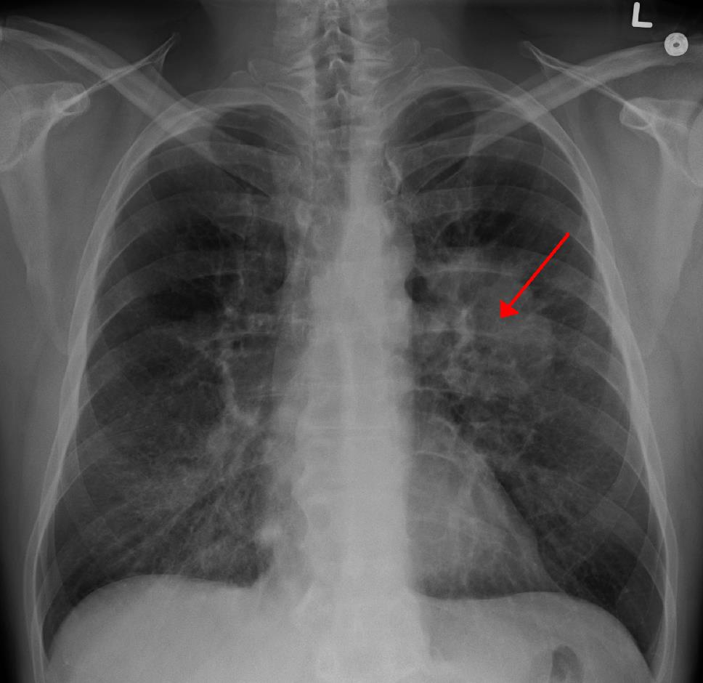
Lung Cancer
Analysis

Slide 2

Impact of Cigarettes
Does Tobacco have an influence on lung cancer?

Slide 3
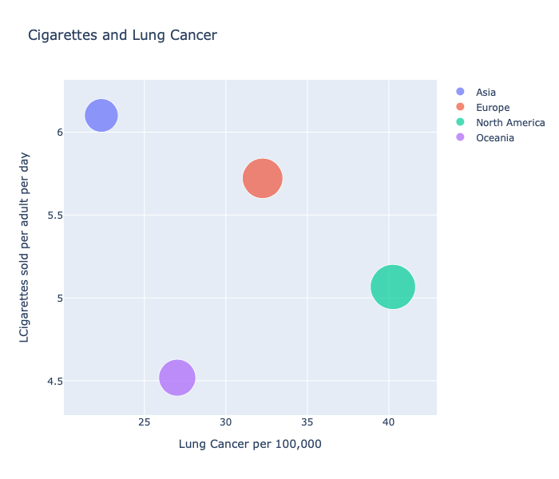
North America & Europe are the areas of the globe which are the most affected by Lung Cancer.
N America

Slide 4
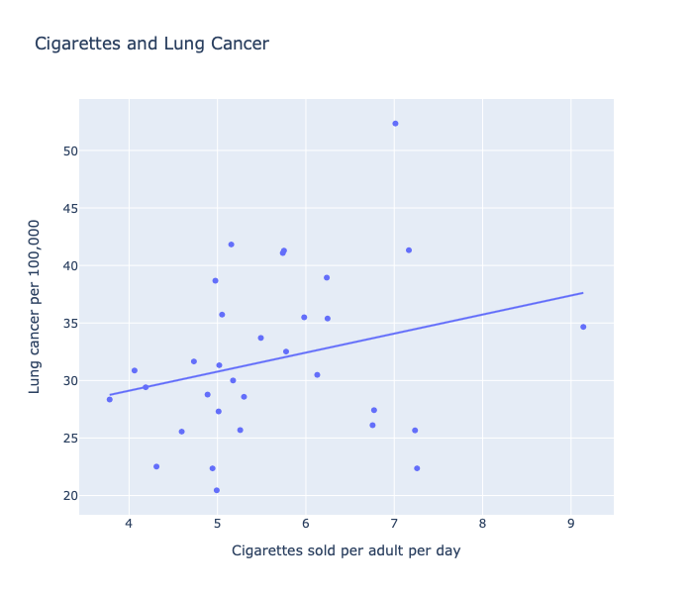
Hungary
There is a positive relationship between Cigarettes sold and lung cancer.
Hungary = worst country in term of lung cancer
Greece = worst country in term of cigarettes sold
Greece

Slide 5
Share of cancer deaths
What are the regions of the world where the share of cancer deaths attributed to tobacco (%) is more significant?

Slide 6
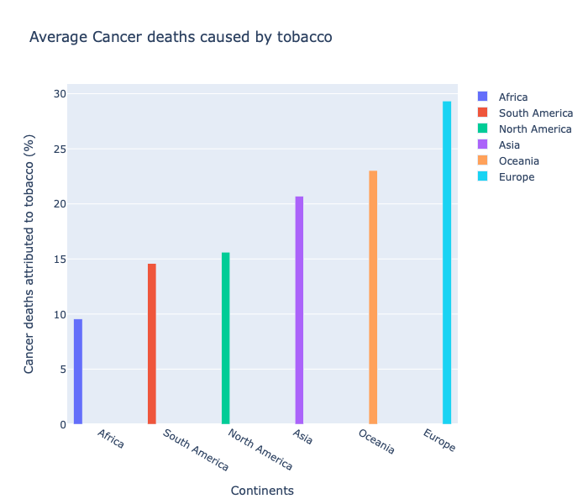
We can observe that Europe has almost 30% of cancer that is caused by tobacco.

Slide 7
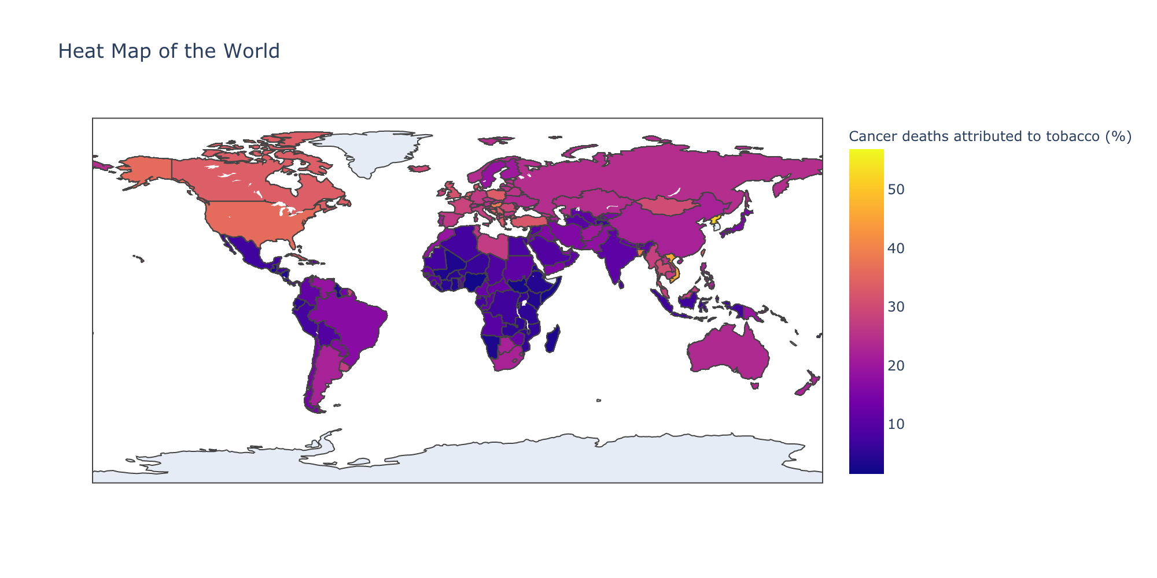
The most important regions affected are: Northern America & Eastern Europe.

Slide 8
Impact of Wealth
Wealth influences the survival rate?

Slide 9
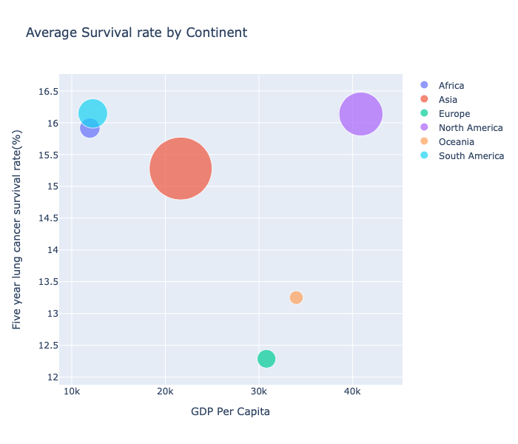
N America
S America
Continents with the highest GDP per Capita does not always have the strongest survival rate.

Slide 10
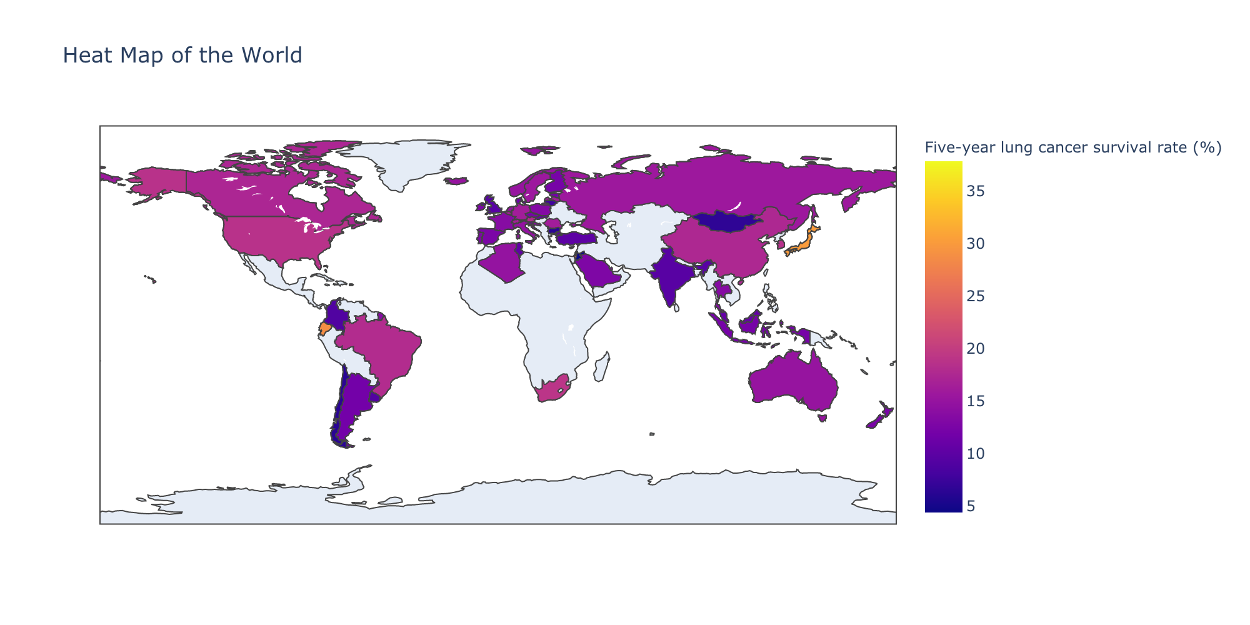
North America shows the best survival rate.

Slide 11

Thank you for your attention

